Slide 1
Analyzing Soccer from Another Angle
Kevin Stern
Notes:
[intro]
Alternative Angle
Spark Discussion
Hi I’m Kevin, and my project goal was to use computer vision techniques to provide an alternative angle, specifically a birds eye-view of players movements, to hopefully spark a more meaningful discussion around strategies in soccer.

Slide 2
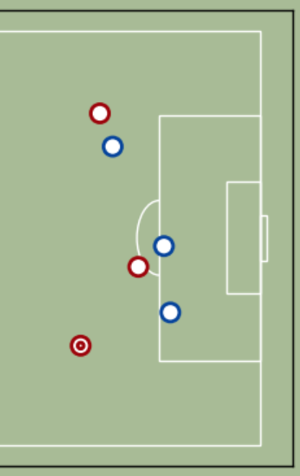
Motivation
Current discussion of strategy is lacking
No player tracking data available
Notes:
[Motivation]
Avid Fan
Unsatisfied with current metrics
X,Y – CV to Map

Slide 3
Implementation – Road Map
Track Players and Team
Isolate Markings on Field
Detect Points
Perspective Warp
Notes:
[implementation]
Decided to use OpenCV, which is a python library that I hadn’t heard of until a few weeks ago, that is mainly aimed at computer vision techniques.
Track players and assign them to a team
To detect what part of the field the camera is capturing
To find 4 points in the video, that I knew the location of on my generated 2d pitch
Warp perspective from camera angle to birds eye view, which I’ll get more into later.

Slide 4
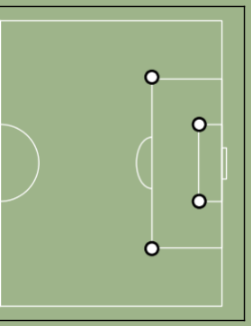
Implementation – Road Map
Track Players and Team
Isolate Markings on Field
Detect Points
Perspective Warp
Notes:
[implementation]
These 4 points most common

Slide 5
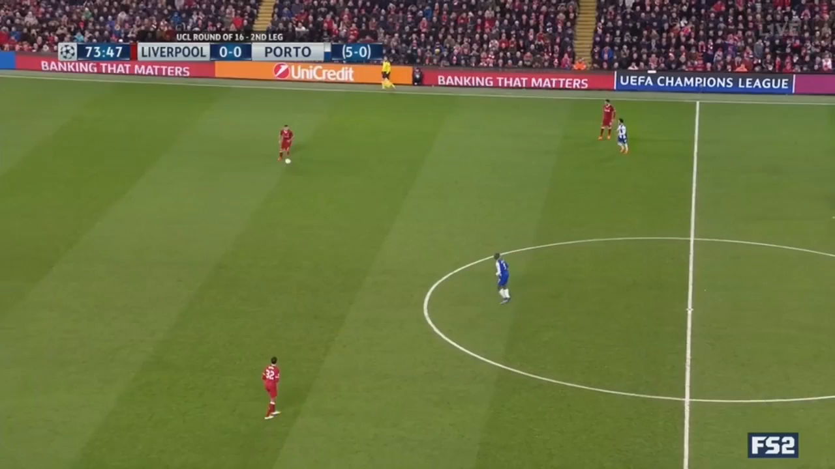
Detect Points
Track Players
Isolate Markings
Assign Teams
Notes:
[implementation]
Here's a quick demonstration of all these processes in action.
For a given video clip, I would read in each frame, isolate anything that wasn’t the background color, and draw a bounding box around that object.
[implementation]
I then ran a k-nearest neighbor algorithm to find the dominant colors within these boxes, did this for each frame, and ended up with the most dominant colors surrounding the detected objects across the entire video.
Now I had some reference colors to assign these objects to teams
From here, I would go through the video again, and assign tracked objects to a team based on how similar the colors in the box were to the dominant non-pitch colors across the video.
I would also store the players x and y coordinates per frame
[implementation]
The next step was to use color and edge detection to isolate markings on the pitch, so that I could determine what part of the pitch is being captured.
I then drew the contours around the markings on the pitch, and used hough lines to draw the most probabilistic lines along where the contours were drawn, which gave me clean lines where I could easily isolate the 4 points of interest.

Slide 6
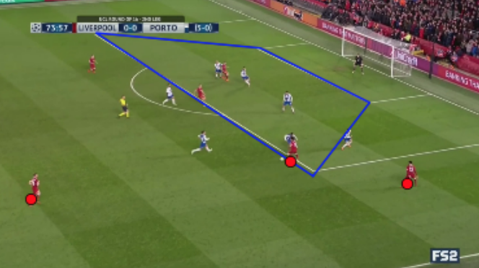
Perspective Warp
Notes:
[implementation]
-Warp
-Simple Terms
-Players to 2d

Slide 7
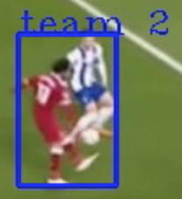
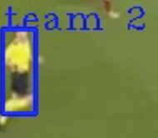
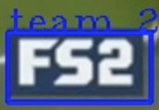
Challenges - Misclassification
Team assignment
Objects/players being misclassified
Notes:
[challenges]
- Two players in same bounding box
Referee/Fox Sports logo misclassified

Slide 8
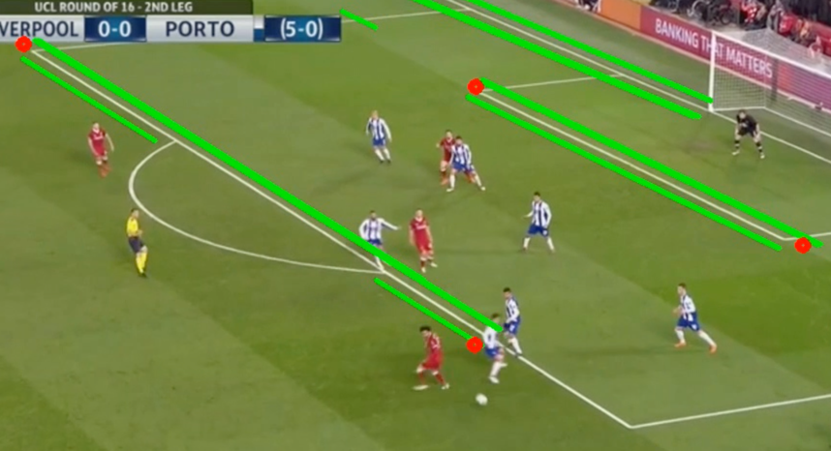
Challenges - Occlusion
Players interfere with markings on pitch
Can’t start mapping players until 4 points are visible
Notes:
[challenges]
Break up markings on the pitch
adversely affects reference points, which can throw the mapping off
Can’t draw until 4

Slide 9
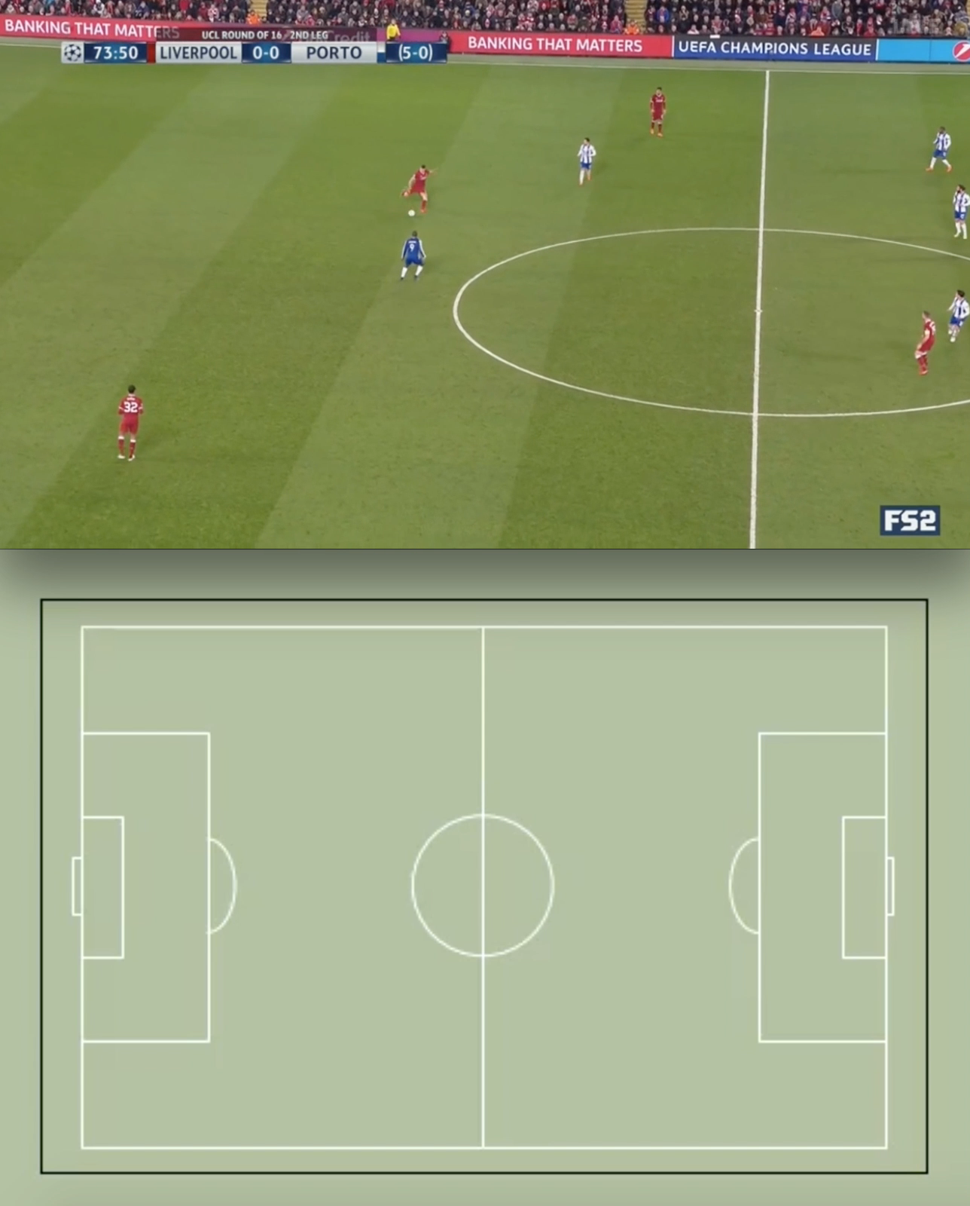
Notes:
Quick demo
With that being said, here’s a quick demo of how the players movements in this clip are being tracked on the 2d pitch.

Slide 10
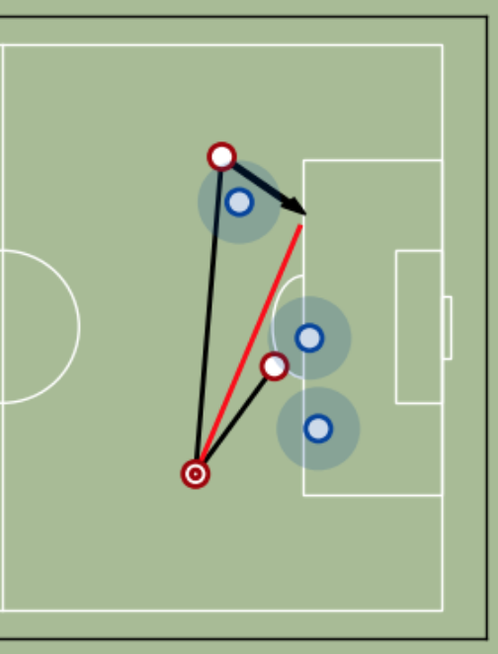
Applications
Passing options
Space utilization
Defensive shape
Notes:
[other applications]

Slide 11

Thank you!
kevinsternhk@gmail.com
kstern31
Notes:
Picture & contact information

